Slide 1
Optimisation for CPU Inference (Chapter 4)

Slide 2
Learning Outcomes
By the end of this session, you will know how to:
Apply algorithmic optimizations for CPU inference, including:
Linear quantization
Network pruning
Optimize matrix multiplication through:
Loop tiling
Loop re-ordering
Loop unrolling
Multi-threading
Leverage Arm CPU SIMD technologies for faster inference:
NEON
Scalable Vector Extension (SVE)
Int8 Matrix Multiply (I8MM)
Scalable Matrix Extension (SME)
Combine these methods with the Kleidi uKernel to maximize performance.
Notes:
Overview of the session's goals for optimizing CPU inference.
Algorithmic optimizations: linear quantization and network pruning.
Matrix multiplication optimizations: loop tiling, re-ordering, unrolling, and multi-threading.
SIMD acceleration techniques using Arm CPU features like NEON, SVE, and I8MM for increased data parallelism
Combining these techniques with Kleidi uKernel a low-level operator library for maximum performance.

Slide 3

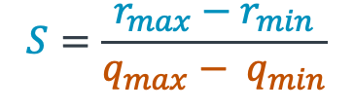
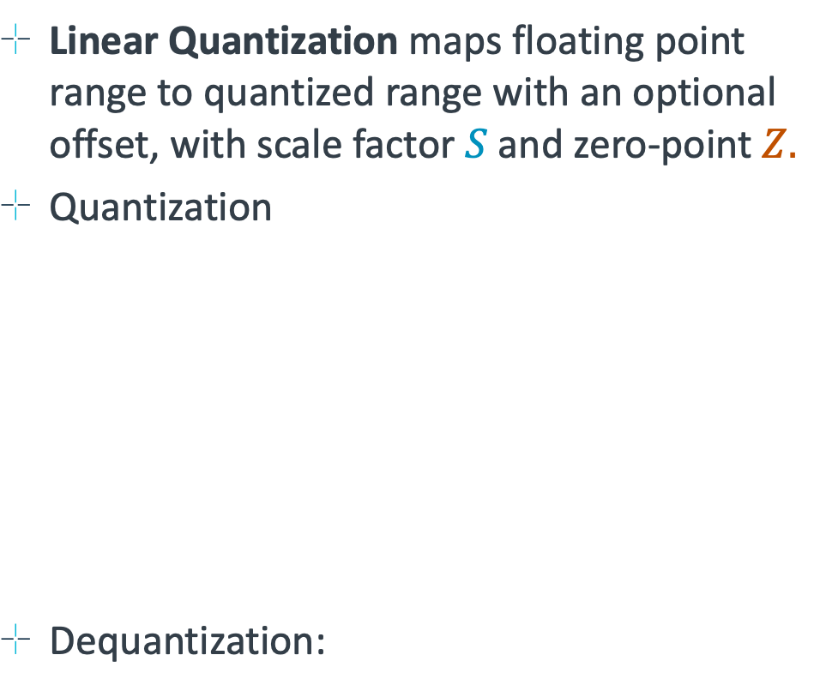
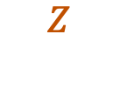

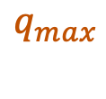
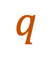
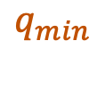
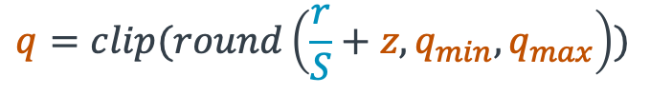



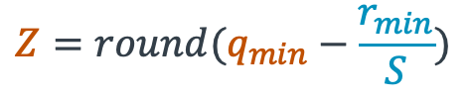
Linear Quantization
Linear Quantization maps floating point range to quantized range with an optional offset, with scale factor $S$ and zero-point $Z.$
Quantization
Dequantization:
Floating-point
Integer
$$r_{min}$$
$$0$$
$$r_{max}$$
$$S=\frac{r_{max}−r_{min}}{q_{max}− q_{min}}$$
$$r$$
Floating Point Range
$$Z=round(q_{min}−\frac{r_{min}}{S})$$
$$q=clip(round\left(\frac{r}{S}+z, q_{min}, q_{max}\right))$$
$$q$$
$$q_{min}$$
$$Z$$
$$q_{max}$$
$$\tilde{r}=\left(q −Z\right) × S$$
Notes:
Converts floating point values to a quantized range for efficiency.
Scale factor (S) determines mapping between floating-point and integer values.
Zero-point (Z) accounts for offset in quantized representation.
Clipping and rounding ensure values remain in the valid range.
Dequantization reverses the process for approximate floating-point recovery.

Slide 4
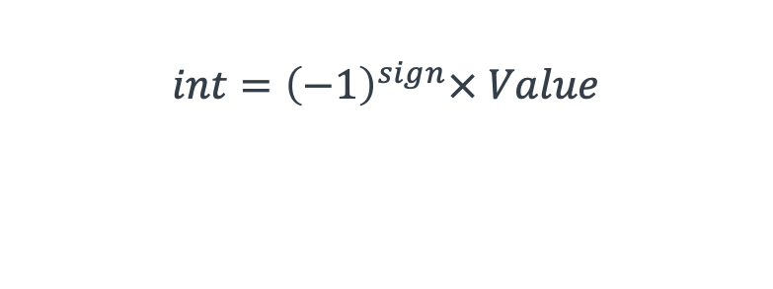

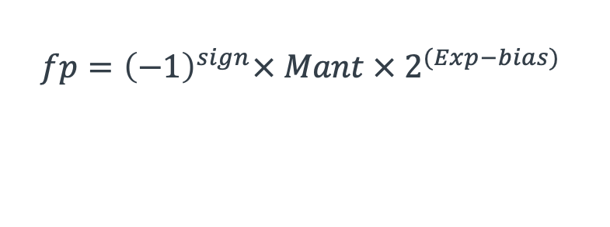

Data Formats on ARM
Sign bits
Value bits
Data Formats (fp32 -> fp16/bfp16 -> int8 -> int4)
Reduces bit width of parameters to lower memory and compute cost.
Reducing Bit-widths reduces numerical precision (the number of representable values)
Bf16 has higher dynamic range compared to fp16, and avoids overflow errors
Exponent bits
Mantissa bits
int4
int8
$$int={\left(−1\right)}^{sign}× Value$$
$$fp={\left(−1\right)}^{sign}× Mant × 2^{(Exp−bias) }$$
bf16
fp16
fp32
Notes:
Different numerical formats: fp32, fp16, bf16, int8, and int4.
Lower bit-widths reduce memory and computational cost.
Trade-off: reduced numerical precision for efficiency gains.
bfloat16 (bf16) has a higher dynamic range than fp16, preventing overflow errors.
Integer representations optimize performance in low-precision inference.

Slide 5
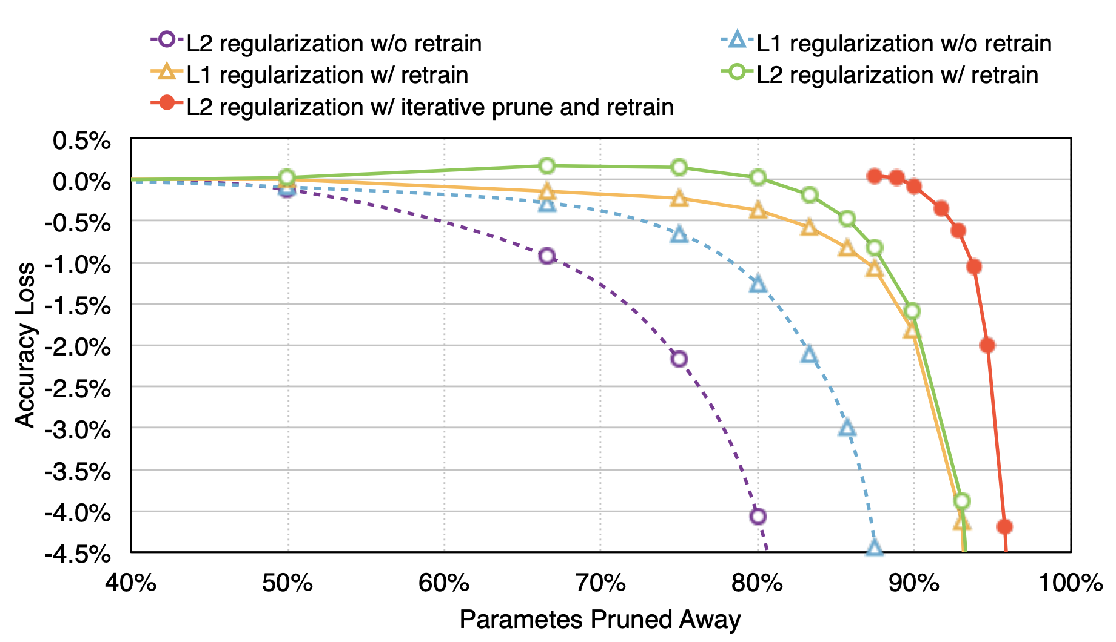
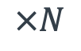
Neural Network Pruning
Pruning removes redundant weights, neurons or activations from the network.
High level of unstructured sparsity can be achieved with minimal accuracy loss
A common approach, Iterative Magnitude Pruning:
Train a Dense Network
Remove smallest p% of weights
Connection Pruning
$$×N$$
Neuron Pruning
Output Pruned Network
Fine-tune
Dense Network
Pruned Network
Learning Both Weights and Connections for Efficient Neural Network [Hanetal., NeurIPS 2015]
Notes:
Removes redundant neurons, weights, or activations to improve efficiency.
Unstructured sparsity minimizes accuracy loss while reducing compute.
Iterative Magnitude Pruning: gradually removing the lowest-magnitude weights.
Fine-tuning ensures the network maintains performance after pruning.
Different pruning strategies: neuron pruning vs. connection pruning.

Slide 6
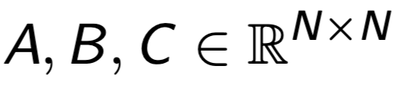
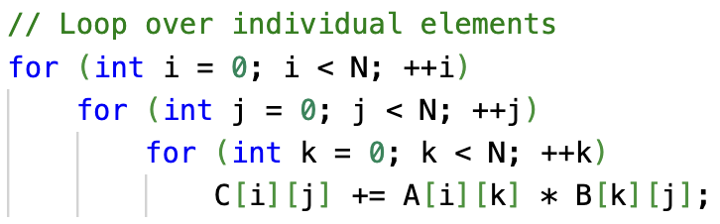
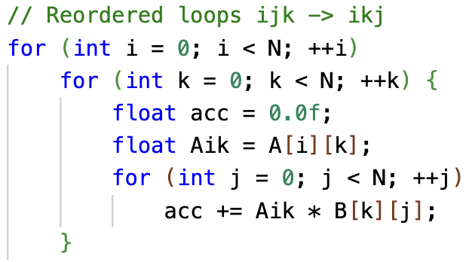
Implementation Optimization: Loop Re-ordering
Naïve matrix multiplication loops can be re-ordered.
The ordering affects memory access pattern.
Loop re-ordering improves access pattern in A and B
Naïve Matrix Multiplication
When Matrices are stored in Row-Major order
Row Access = A[6:12]
Loop Re-ordered Matrix Multiplication
Column Access = A[0], A[7], A[13], …
Notes:
Improves memory access patterns in matrix multiplication.
Standard naive matrix multiplication follows an inefficient access pattern.
Row-major storage affects how data is accessed in memory.
Re-ordering loops (ijk → ikj) improves data locality and reduces cache misses.
Significant speed-up in large matrix multiplications.

Slide 7
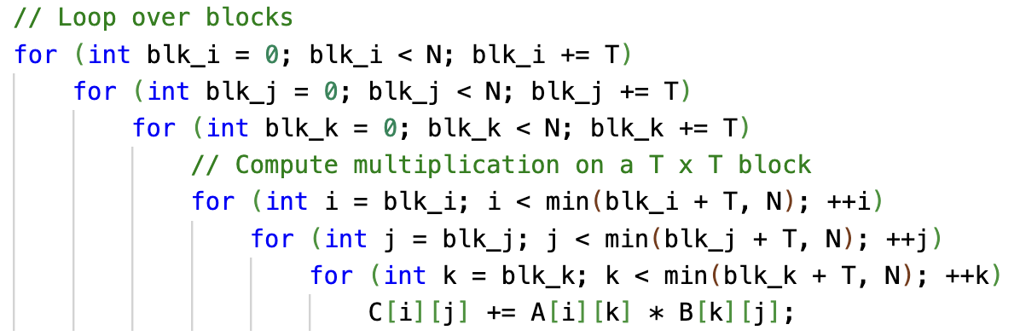
Implementation Optimization: Tiling
Matrix Multiplication is an Extremely parallelizable operation.
Matrices of GenAI models are huge!
Can be N >> 1024
Main memory access slow, cache is fast.
Global DRAM is much slower than on-chip caches
Reducing global memory access, speeds up inference.
Tiling reuses rows/columns in cache, boosting performance
Increases Ops/DRAM memory access ratio.
Naïve matrix multiplication
Tiled matrix multiplication
Notes:
Matrix multiplication is highly parallelizable but memory-bound.
DRAM access is slow compared to on-chip cache.
Tiling partitions matrices into smaller blocks to fit within cache.
Reusing data in cache improves efficiency and reduces DRAM bottlenecks.
Results in higher ops/memory access ratio and improved inference speed.

Slide 8
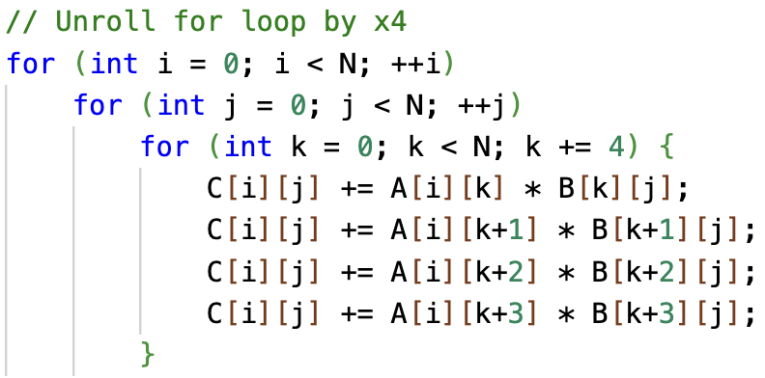
Implementation Optimization: Loop Unrolling
Matrix Multiplications provide branching overhead
Have to evaluate:
i < N
j < N
k < N
Reduces branching overhead
Better Instruction scheduling
Exposing more independent operations, allows CPU to schedule parallel pipelines.
Reduced Branch Misprediction Penalties
Naïve matrix multiplication
Unrolled matrix multiplication
Notes:
Matrix multiplications introduce branching overhead due to loop evaluations.
Unrolling loops reduces branching overhead, improving execution speed.
Allows better instruction scheduling by exposing more independent operations.
Reduces branch misprediction penalties, minimizing performance stalls.
Example shows unrolling by a factor of four, processing multiple iterations in one step.

Slide 9
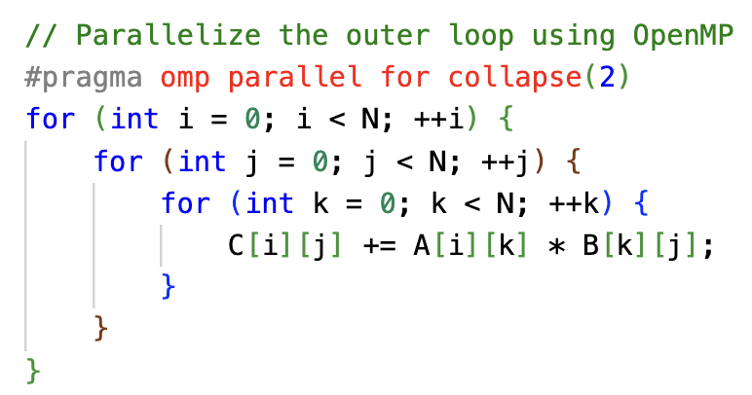
Multi-Core Parallel Programming on ARM
Matrix multiplication is highly parallelizable.
It can exploit multiple cores or threads simultaneously for faster execution.
Multi-threading boosts throughput.
Different parts of the matrix multiplication can run on separate threads or cores.
Output matric C can be chunked, and its computation distributed across threads.
Modern Arm and cloud processors often support simultaneous multithreading (SMT).
This allows more than one thread of execution per core, further increasing parallelism.
Parallelized Naïve Matrix Multiplication
Notes:
Matrix multiplication is highly parallelizable and benefits from multi-core execution.
Multi-threading allows different parts of the matrix to be processed simultaneously.
Arm and cloud processors support simultaneous multithreading (SMT) for increased parallelism.
OpenMP is a common tool for parallelizing loops efficiently.
Code example illustrates how to parallelize the outer loop using OpenMP.

Slide 10
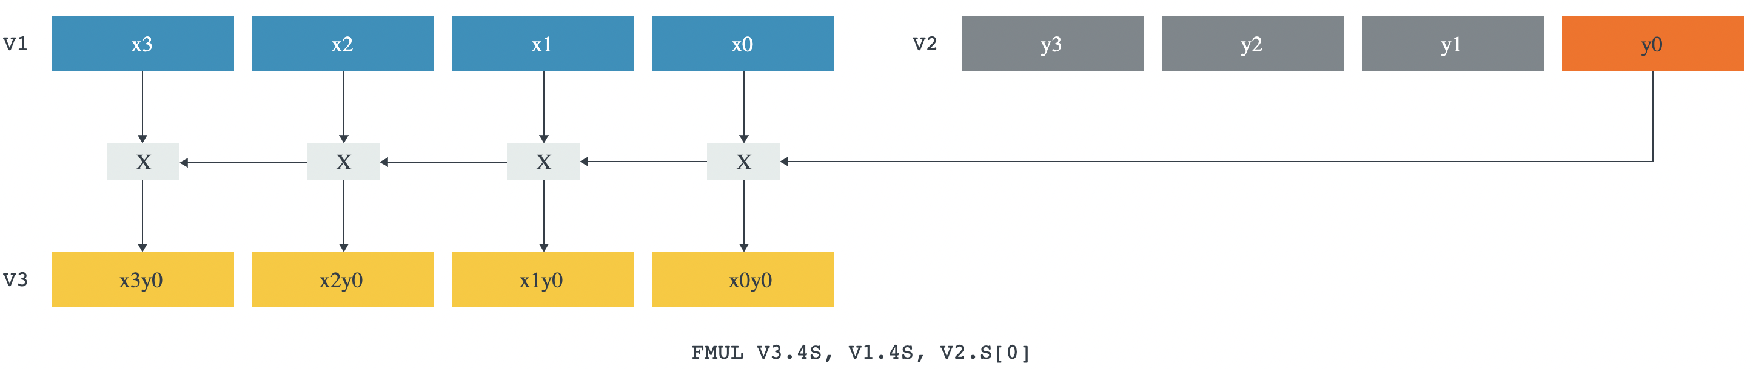
Overview of ARM’s SIMD Capabilities
Single instruction multiple data (SIMD)
Performs the same operation on multiple data elements concurrently
Increases throughput for matrix multiplication
Arms advanced implementation of SIMD instructions is the NEON feature.
NEON Vector Multiplication
Arm Advanced SIMD Features:
Scalable Vector Extension
Increased vectorization and enhanced throughput.
Introduces vector-length agnostic approach.
I8MM
Feature of Arm Processors to accelerate integer matrix multiply
Specifically suited for INT8 quantized networks
Multiplies 2x8, 8x2 matrix segments to output 2x2 results.
SME
Builds on NEON to use 2D vectorization
Specifically developed for matrix multiply operations
Extends SVE concepts by adding dedicated instructions for matrix-based computations.
Notes:
SIMD (Single Instruction Multiple Data) executes the same operation on multiple elements in parallel.
NEON is ARM’s SIMD implementation for vectorized operations.
Scalable Vector Extension (SVE) improves vectorization by supporting variable-length registers.
I8MM accelerates integer matrix multiplication, useful for quantized models.
SME (Scalable Matrix Extension) builds on NEON and SVE for 2D vectorization.

Slide 11


I8MM: Accelerated Int8 Matrix Multiplication
Quantization can reduce precision to INT8
I8MM designed to specifically accelerate INT8 Matrix Multiplication.
SMMLA (vector) instruction will deliver a peak integer multiply throughput that is at least as high as can be achieved using two SDOT (vector) instructions
Mandatory features of Armv8.6+
$$×$$
$$=$$
SMMLA <Vd>.4S, <Vn>.16B, <Vm>.16B
<Vd> the destination register
<Vn> is the first source register
<Vm> the second source register
Notes:
Quantization reduces precision to INT8, improving efficiency.
I8MM accelerates INT8 matrix multiplication with specific hardware instructions.
SMLA vector instruction delivers peak integer multiply throughput.
Mandatory feature for Armv8.6+ architecture.

Slide 12
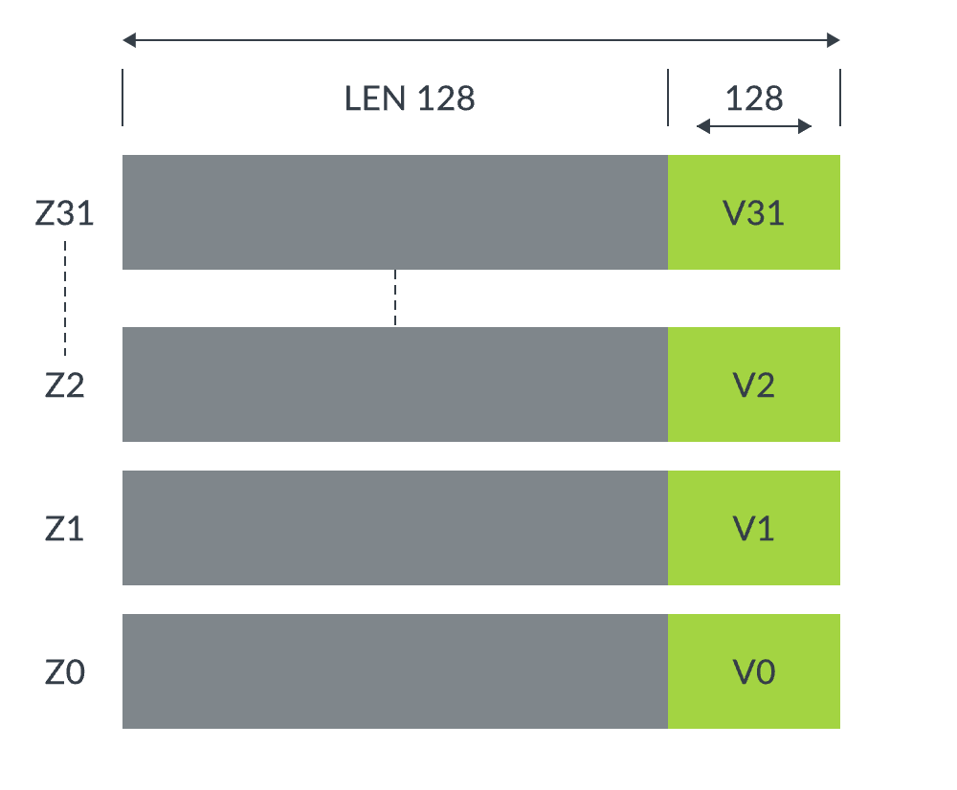
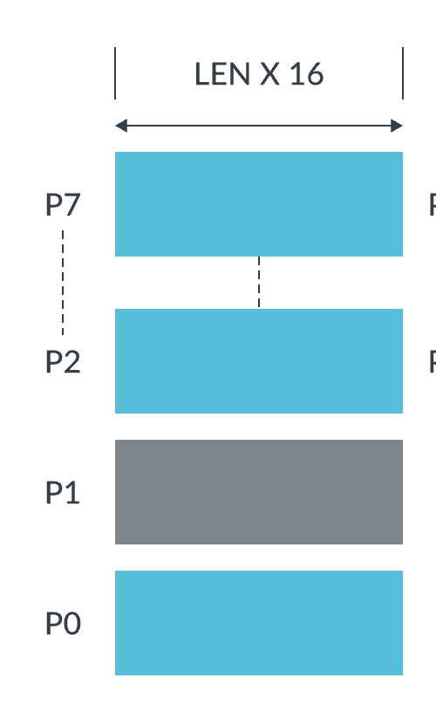
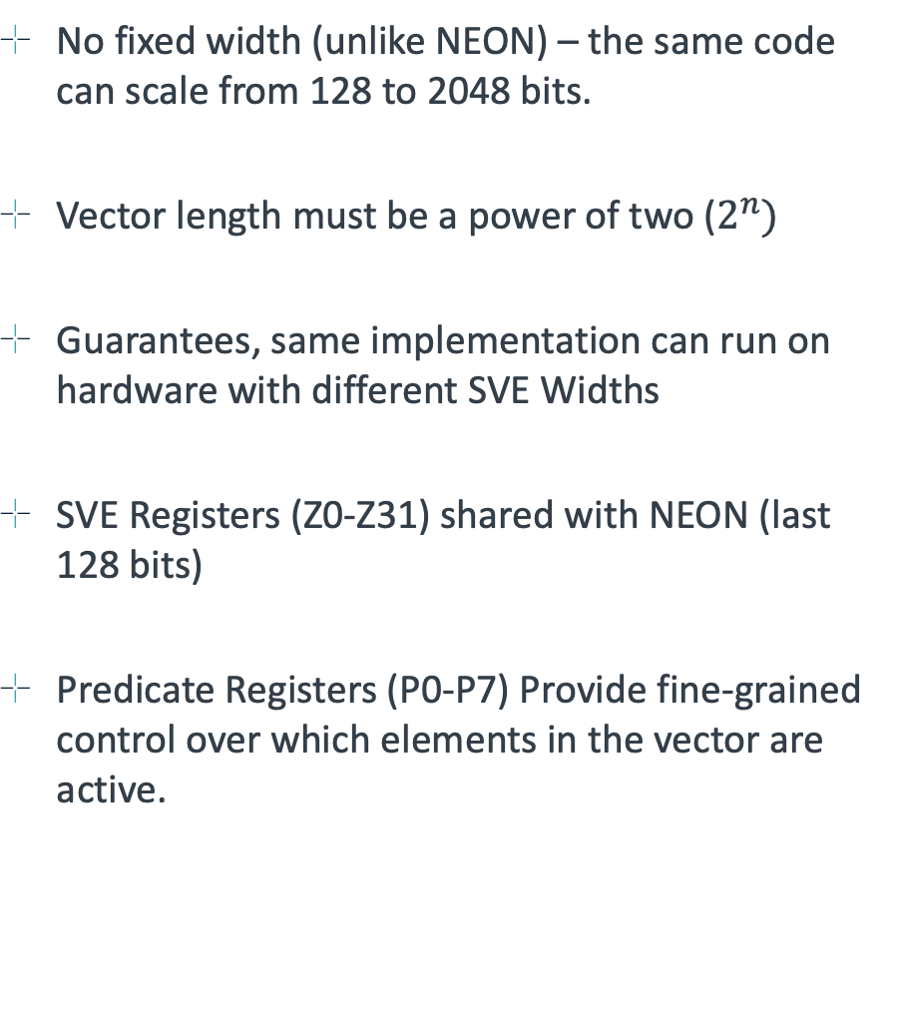
Scalable Vector Extension (SVE)
No fixed width (unlike NEON) – the same code can scale from 128 to 2048 bits.
Vector length must be a power of two ($2^{n})$
Guarantees, same implementation can run on hardware with different SVE Widths
SVE Registers (Z0-Z31) shared with NEON (last 128 bits)
Predicate Registers (P0-P7) Provide fine-grained control over which elements in the vector are active.
SVE Registers (Z0-Z31)
Predicate Registers (P0-P7)
Notes:
Unlike NEON, SVE implementations can scale from 128 to 2048 bits, making it more flexible.
Vector length design implementations must be a power of two, ensuring compatibility.
Code using SVE can run on different vector widths without modification.
Registers Z0-Z31 are shared with NEON for compatibility.
Predicate registers (P0-P7) allow fine-grained control over vector execution.

Slide 13
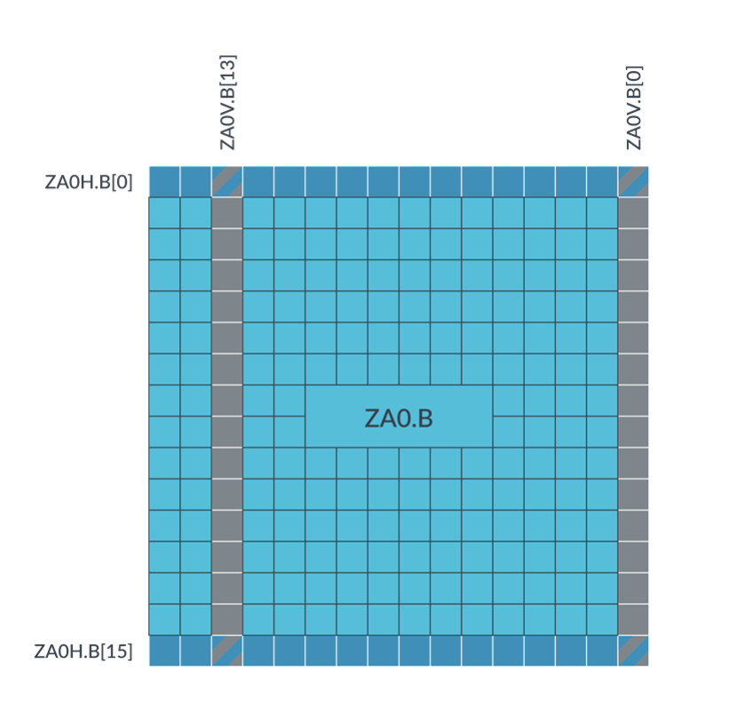
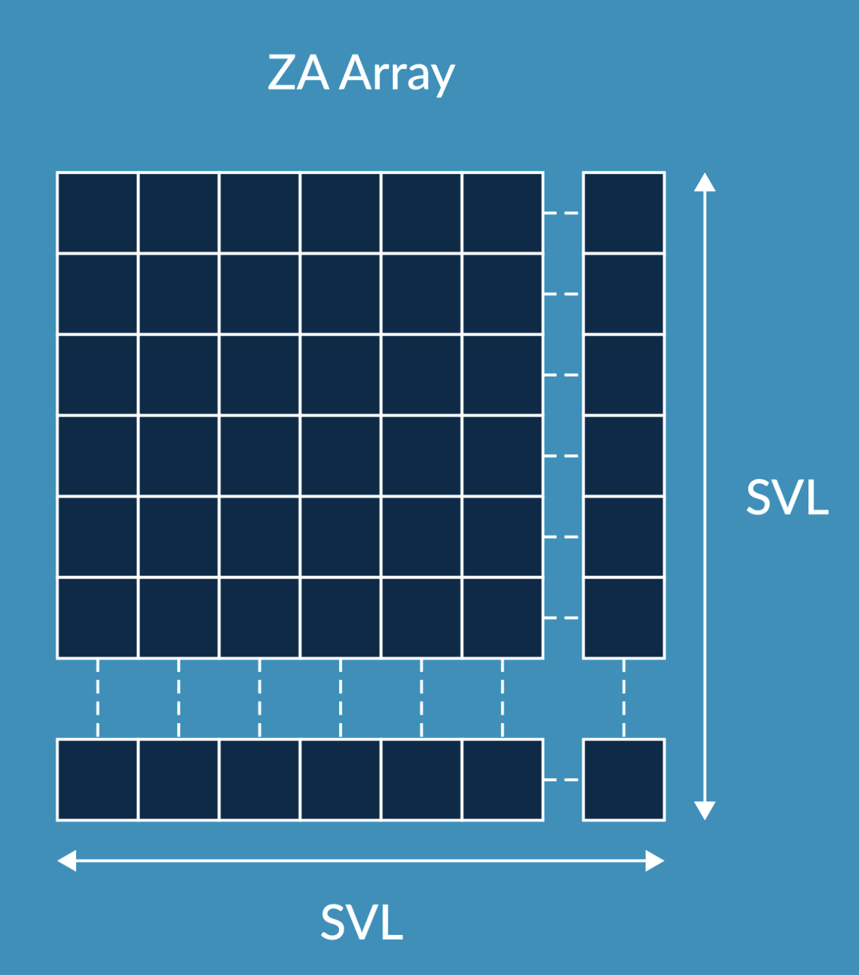
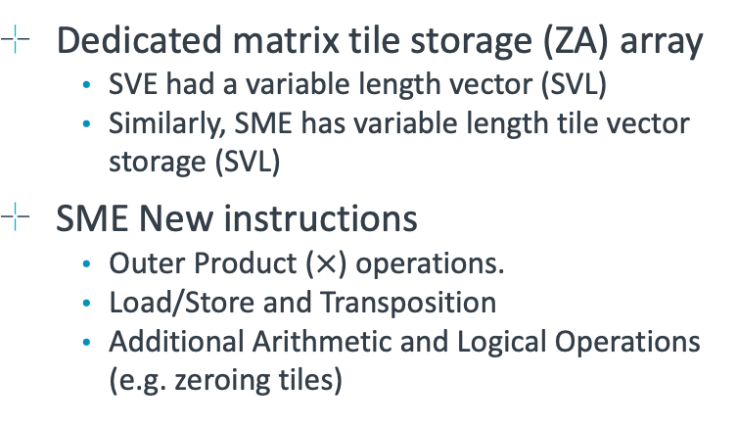
Scalable Matrix Extension (SME)
ZAOH.B[n] accesses the nth row
ZAOV.B[n] accesses the nth column
Matrix tile storage (ZA Array)
ZA Array memory access
An extension to SVE to operate on matrix tiles
Streaming SVE mode adds new instructions specifically for matrix multiplication
Dedicated matrix tile storage (ZA) array
Just like SVE, SME has variable length tile vector storage (SVL)
Dedicated matrix tile storage (ZA) array
SVE had a variable length vector (SVL)
Similarly, SME has variable length tile vector storage (SVL)
SME New instructions
Outer Product ($×$) operations.
Load/Store and Transposition
Additional Arithmetic and Logical Operations (e.g. zeroing tiles)
Notes:
SME extends SVE to operate on matrix tiles, improving efficiency.
Streaming SVE mode introduces new instructions for optimized matrix multiplication.
Dedicated ZA matrix storage allows for more efficient tile-based computation.
ZA storage supports row and column accesses, optimizing memory layout.
New SME instructions include outer product operations, transposition, and logical operations.

Slide 14
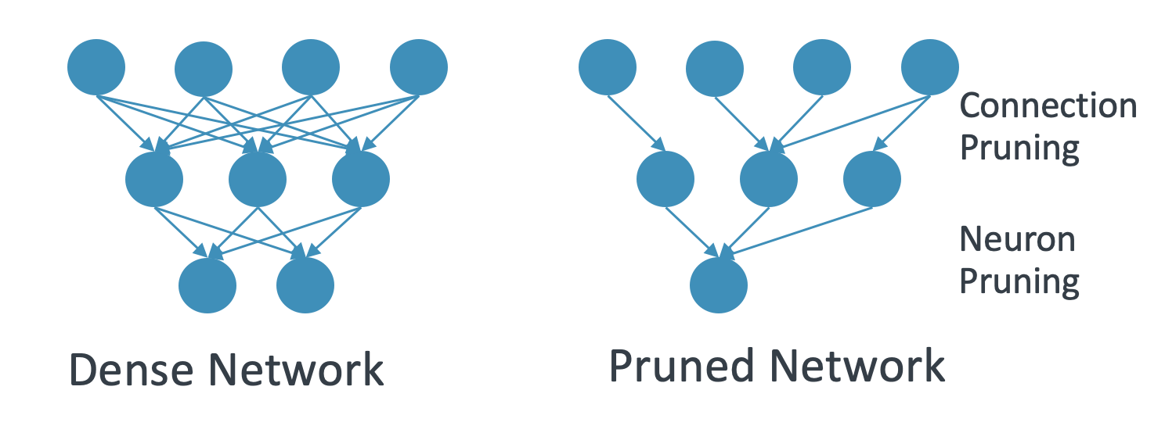
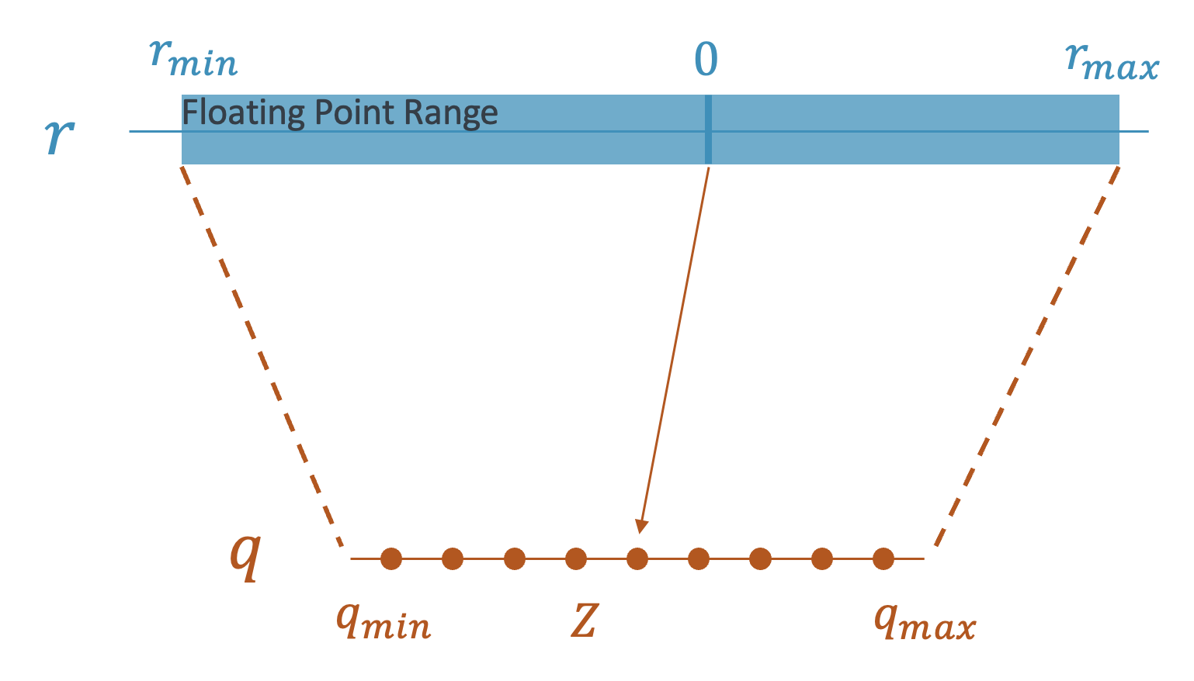
What we have covered so far
Algorithmic Optimizations
Quantization (e.g., INT8) for faster compute
Pruning to reduce computation & memory footprint
Implementation Optimizations
Loop Tiling & Blocking for cache locality
Loop Reordering for improved memory access pattern
Loop Unrolling for reduced overhead
Multi-Threading for core-level parallelism
ARM Architecture Features
NEON (SIMD)
SVE (Scalable Vector Extension)
I8MM (Integer Matrix Multiply)
SME (Scalable Matrix Extension)
Pruning
Quantization
Loop Tiling
Notes:
Algorithmic optimizations such as quantization and pruning improve efficiency.
Implementation details like loop tiling, reordering, and unrolling enhance performance.
ARM architecture features such as SVE, I8MM, and SME enable specialized optimizations.
Multi-threading helps maximize core utilization for parallel computation.

Slide 15
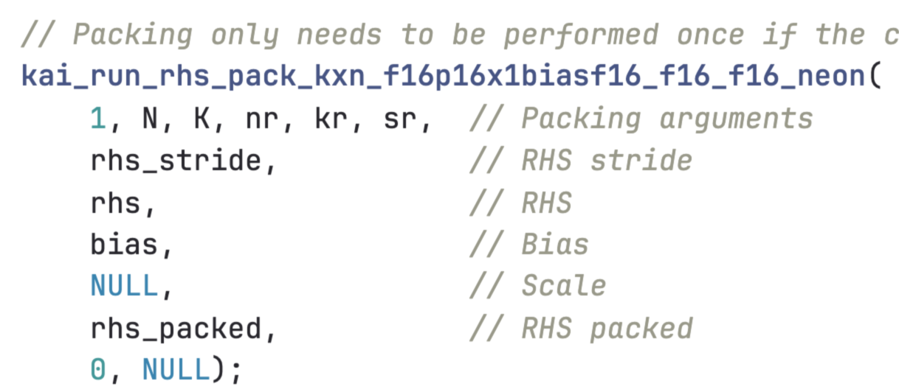
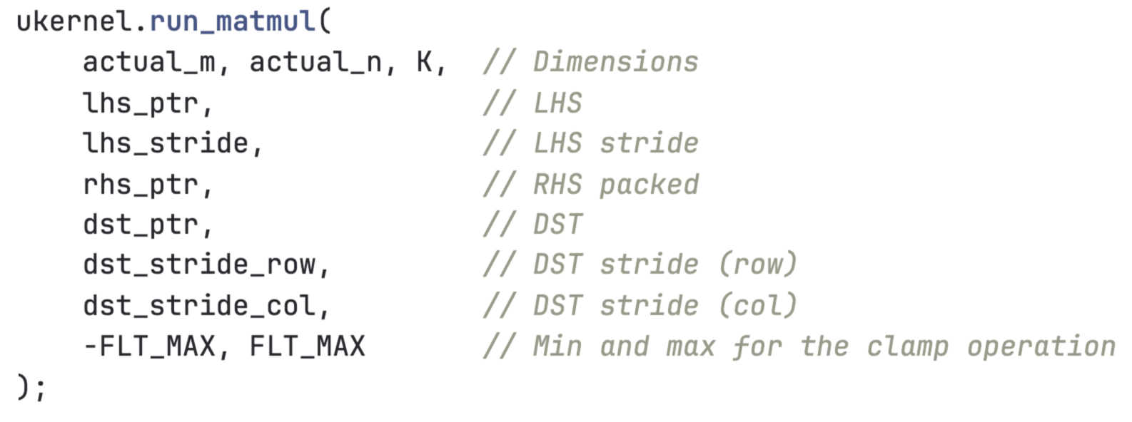
Bringing It All Together in KleidiAI
KleidiAI: https://gitlab.arm.com/kleidi/kleidiai
What is KleidiAI?
Open-source library of performance-critical micro-kernels for Arm CPUs
Designed for easy integration in C/C++ AI/ML frameworks
Operators are extremely well optimized, written in hand-crafted assembly.
ukernel
A number of variants each implemented with different datatype/features (I8MM, SVE, …)
Can be multithreaded to produce a full Matrix Multiply.
Packing the weight matrix (rhs) for efficient memory access
Run the KleidiAI Matmul ukernel
Notes:
KleidiAI is an open-source library of optimized micro-kernels for ARM CPUs.
Designed for integration in C/C++ AI/ML frameworks.
uKernel provides multiple variants with different datatypes like I8MM and SVE.
Supports multithreading for full matrix multiplication.
Example code shows efficient weight matrix packing and execution.

Slide 16
Summary
Algorithmic Optimizations
Linear Quantization reduces model size and improves compute efficiency.
Network Pruning removes redundant parameters to speed up inference.
Implementation Techniques
Loop Tiling, Re-ordering, and Unrolling optimize matrix multiplication performance.
Multi-threading leverages parallelism for higher throughput.
Arm CPU SIMD Technologies
NEON, SVE, I8MM, and SME provide specialized hardware instructions for faster matrix operations.
Kleidi uKernel Integration
Combining these methods with Kleidi µKernel yields maximal CPU inference performance.
Notes:
Linear quantization reduces model size and improves computational efficiency.
Network pruning eliminates redundant parameters to speed up inference.
Implementation techniques like loop tiling, reordering, and unrolling optimize performance.
Multi-threading allows leveraging CPU parallelism.
ARM CPU SIMD technologies like NEON, SVE, I8MM, and SME provide specialized hardware acceleration.
Combining these methods with KleidiAI yields maximum CPU inference performance.

Slide 17
Questions and Discussion

